Slide 1
Design and Analysis of Algorithms
Algorithms-II : CS345A
Lecture 33
Fast Matrix Multiplication
II
and its Applications

Slide 2
RECAP of the Last Lecture

Slide 3



Fast Matrix Multiplication
Volker Strassen, 1969
$$=Θ(n^{2.81})$$
Virginia Vassilevska Williams, 2020
$$=Θ(n^{2.37286})$$
$ω=2.37286$

Slide 4
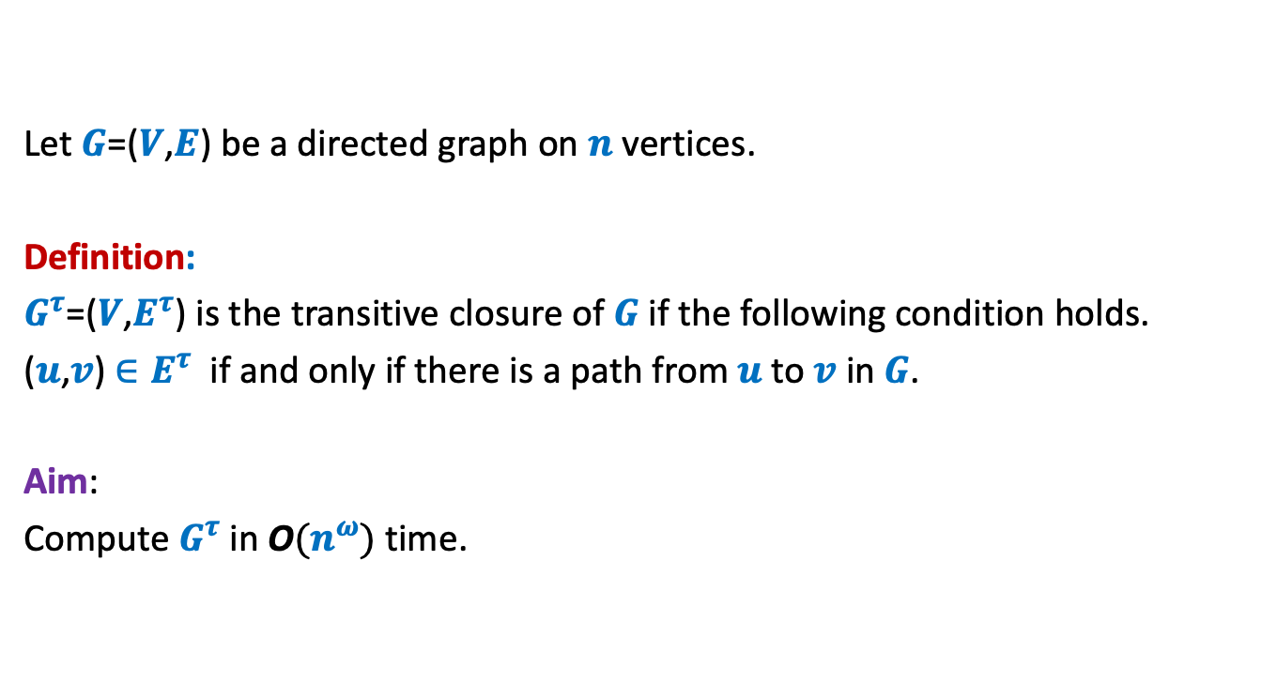
Transitive Closure of Graph
Let $G$=($V$,$E$) be a directed graph on $n$ vertices.
Definition:
$G^{τ}$=($V$,$E^{τ}$) is the transitive closure of $G$if the following condition holds.
($u$,$v$) $∈E^{τ}$ if and only if there is a path from $u$to $v$ in $G$.
Aim:
Compute $G^{τ}$in O$(n^{ω})$ time.

Slide 5






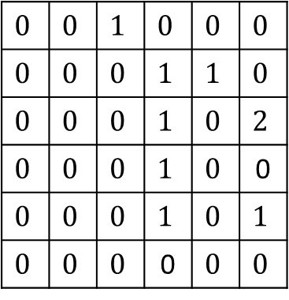
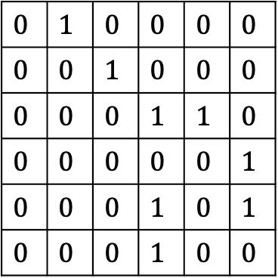


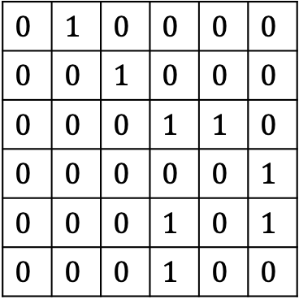







$$1$$ | $$2$$ | $$3$$ | $$4$$ | $$5$$ | $$6$$
$$1$$ | $$2$$ | $$3$$ | $$4$$ | $$5$$ | $$6$$
$$1$$
$$2$$
$$3$$
$$4$$
$$5$$
$$6$$
$$0$$ | $$1$$ | $$0$$ | $$0$$ | $$0$$ | $$0$$
$$0$$ | $$0$$ | $$1$$ | $$0$$ | $$0$$ | $$0$$
$$0$$ | $$0$$ | $$0$$ | $$1$$ | $$1$$ | $$0$$
$$0$$ | $$0$$ | $$0$$ | $$0$$ | $$0$$ | $$1$$
$$0$$ | $$0$$ | $$0$$ | $$1$$ | $$0$$ | $$1$$
$$0$$ | $$0$$ | $$0$$ | $$1$$ | $$0$$ | $$0$$
$$0$$ | $$1$$ | $$0$$ | $$0$$ | $$0$$ | $$0$$
$$0$$ | $$0$$ | $$1$$ | $$0$$ | $$0$$ | $$0$$
$$0$$ | $$0$$ | $$0$$ | $$1$$ | $$1$$ | $$0$$
$$0$$ | $$0$$ | $$0$$ | $$0$$ | $$0$$ | $$1$$
$$0$$ | $$0$$ | $$0$$ | $$1$$ | $$0$$ | $$1$$
$$0$$ | $$0$$ | $$0$$ | $$1$$ | $$0$$ | $$0$$
$$1$$
$$2$$
$$3$$
$$4$$
$$5$$
$$6$$
$$0$$ | $$0$$ | $$1$$ | $$0$$ | $$0$$ | $$0$$
$$0$$ | $$0$$ | $$0$$ | $$1$$ | $$1$$ | $$0$$
$$0$$ | $$0$$ | $$0$$ | $$1$$ | $$0$$ | $$2$$
$$0$$ | $$0$$ | $$0$$ | $$1$$ | $$0$$ | 0
$$0$$ | $$0$$ | $$0$$ | $$1$$ | $$0$$ | $$1$$
$$0$$ | $$0$$ | $$0$$ | 0 | $$0$$ | $$0$$
$$A$$
$$A$$
$$Z$$
$$4$$
$$6$$
$$1$$
$$2$$
$$3$$
$$5$$
$$G$$

Slide 6

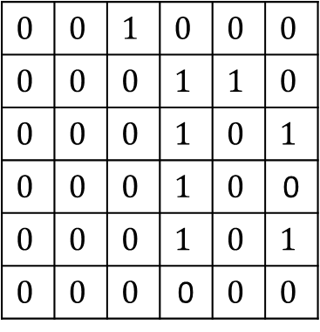
$$1$$ | $$2$$ | $$3$$ | $$4$$ | $$5$$ | $$6$$
$$1$$ | $$2$$ | $$3$$ | $$4$$ | $$5$$ | $$6$$
$$1$$
$$2$$
$$3$$
$$4$$
$$5$$
$$6$$
$$0$$ | $$1$$ | $$0$$ | $$0$$ | $$0$$ | $$0$$
$$0$$ | $$0$$ | $$1$$ | $$0$$ | $$0$$ | $$0$$
$$0$$ | $$0$$ | $$0$$ | $$1$$ | $$1$$ | $$0$$
$$0$$ | $$0$$ | $$0$$ | $$0$$ | $$0$$ | $$1$$
$$0$$ | $$0$$ | $$0$$ | $$1$$ | $$0$$ | $$1$$
$$0$$ | $$0$$ | $$0$$ | $$1$$ | $$0$$ | $$0$$
$$0$$ | $$1$$ | $$0$$ | $$0$$ | $$0$$ | $$0$$
$$0$$ | $$0$$ | $$1$$ | $$0$$ | $$0$$ | $$0$$
$$0$$ | $$0$$ | $$0$$ | $$1$$ | $$1$$ | $$0$$
$$0$$ | $$0$$ | $$0$$ | $$0$$ | $$0$$ | $$1$$
$$0$$ | $$0$$ | $$0$$ | $$1$$ | $$0$$ | $$1$$
$$0$$ | $$0$$ | $$0$$ | $$1$$ | $$0$$ | $$0$$
$$1$$
$$2$$
$$3$$
$$4$$
$$5$$
$$6$$
$$0$$ | $$0$$ | $$1$$ | $$0$$ | $$0$$ | $$0$$
$$0$$ | $$0$$ | $$0$$ | $$1$$ | $$1$$ | $$0$$
$$0$$ | $$0$$ | $$0$$ | $$1$$ | $$0$$ | $$1$$
$$0$$ | $$0$$ | $$0$$ | $$1$$ | $$0$$ | 0
$$0$$ | $$0$$ | $$0$$ | $$1$$ | $$0$$ | $$1$$
$$0$$ | $$0$$ | $$0$$ | 0 | $$0$$ | $$0$$
$$A$$
$$A$$
$$B$$
$$4$$
$$6$$
$$1$$
$$2$$
$$3$$
$$5$$
$$G$$

Slide 7





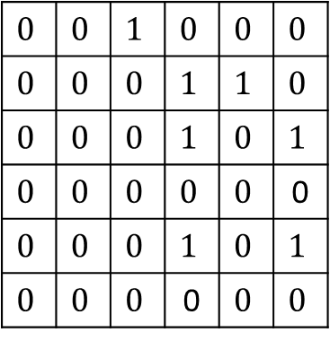



$$1$$ | $$2$$ | $$3$$ | $$4$$ | $$5$$ | $$6$$
$$1$$ | $$2$$ | $$3$$ | $$4$$ | $$5$$ | $$6$$
$$1$$
$$2$$
$$3$$
$$4$$
$$5$$
$$6$$
$$0$$ | $$1$$ | $$0$$ | $$0$$ | $$0$$ | $$0$$
$$0$$ | $$0$$ | $$1$$ | $$0$$ | $$0$$ | $$0$$
$$0$$ | $$0$$ | $$0$$ | $$1$$ | $$1$$ | $$0$$
$$0$$ | $$0$$ | $$0$$ | $$0$$ | $$0$$ | $$1$$
$$0$$ | $$0$$ | $$0$$ | $$1$$ | $$0$$ | $$1$$
$$0$$ | $$0$$ | $$0$$ | $$1$$ | $$0$$ | $$0$$
$$0$$ | $$1$$ | $$0$$ | $$0$$ | $$0$$ | $$0$$
$$0$$ | $$0$$ | $$1$$ | $$0$$ | $$0$$ | $$0$$
$$0$$ | $$0$$ | $$0$$ | $$1$$ | $$1$$ | $$0$$
$$0$$ | $$0$$ | $$0$$ | $$0$$ | $$0$$ | $$1$$
$$0$$ | $$0$$ | $$0$$ | $$1$$ | $$0$$ | $$1$$
$$0$$ | $$0$$ | $$0$$ | $$1$$ | $$0$$ | $$0$$
$$1$$
$$2$$
$$3$$
$$4$$
$$5$$
$$6$$
$$0$$ | $$0$$ | $$1$$ | $$0$$ | $$0$$ | $$0$$
$$0$$ | $$0$$ | $$0$$ | $$1$$ | $$1$$ | $$0$$
$$0$$ | $$0$$ | $$0$$ | $$1$$ | $$0$$ | $$1$$
$$0$$ | $$0$$ | $$0$$ | $$0$$ | $$0$$ | 0
$$0$$ | $$0$$ | $$0$$ | $$1$$ | $$0$$ | $$1$$
$$0$$ | $$0$$ | $$0$$ | 0 | $$0$$ | $$0$$
There is an edge ($i,j$) in the graph corresponding to $B$
if and only if there is a path of length 2 from $i$ to $j$ in $G$.
$$A$$
$$A$$
$$B$$
$$4$$
$$4$$
$$6$$
$$6$$
$$1$$
$$2$$
$$3$$
$$1$$
$$2$$
$$3$$
$$5$$
$$5$$
$$G$$

Slide 8

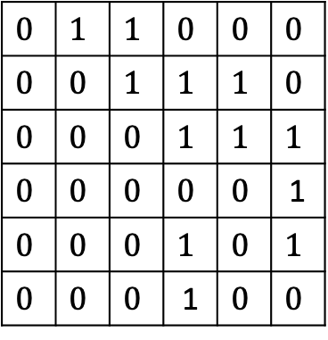


$$1$$ | $$2$$ | $$3$$ | $$4$$ | $$5$$ | $$6$$
$$1$$ | $$2$$ | $$3$$ | $$4$$ | $$5$$ | $$6$$
$$1$$
$$2$$
$$3$$
$$4$$
$$5$$
$$6$$
$$0$$ | $$1$$ | $$0$$ | $$0$$ | $$0$$ | $$0$$
$$0$$ | $$0$$ | $$1$$ | $$0$$ | $$0$$ | $$0$$
$$0$$ | $$0$$ | $$0$$ | $$1$$ | $$1$$ | $$0$$
$$0$$ | $$0$$ | $$0$$ | $$0$$ | $$0$$ | $$1$$
$$0$$ | $$0$$ | $$0$$ | $$1$$ | $$0$$ | $$1$$
$$0$$ | $$0$$ | $$0$$ | $$1$$ | $$0$$ | $$0$$
$$0$$ | $$1$$ | $$0$$ | $$0$$ | $$0$$ | $$0$$
$$0$$ | $$0$$ | $$1$$ | $$0$$ | $$0$$ | $$0$$
$$0$$ | $$0$$ | $$0$$ | $$1$$ | $$1$$ | $$0$$
$$0$$ | $$0$$ | $$0$$ | $$0$$ | $$0$$ | $$1$$
$$0$$ | $$0$$ | $$0$$ | $$1$$ | $$0$$ | $$1$$
$$0$$ | $$0$$ | $$0$$ | $$1$$ | $$0$$ | $$0$$
$$1$$
$$2$$
$$3$$
$$4$$
$$5$$
$$6$$
$$0$$ | $$1$$ | $$1$$ | $$0$$ | $$0$$ | $$0$$
$$0$$ | $$0$$ | $$1$$ | $$1$$ | $$1$$ | $$0$$
$$0$$ | $$0$$ | $$0$$ | $$1$$ | $$1$$ | $$1$$
$$0$$ | $$0$$ | $$0$$ | $$0$$ | $$0$$ | 1
$$0$$ | $$0$$ | $$0$$ | $$1$$ | $$0$$ | $$1$$
$$0$$ | $$0$$ | $$0$$ | 1 | $$0$$ | $$0$$
There is an edge ($i,j$) in the graph corresponding to $B$
if and only if there is a path of length 2 from $i$ to $j$ in $G$.
$$A$$
$$A$$
$$B$$
at most 2 from $i$ to $j$ in $G$.
$$4$$
$$4$$
$$6$$
$$6$$
$$1$$
$$2$$
$$3$$
$$1$$
$$2$$
$$3$$
$$5$$
$$5$$
$$G$$
$$G^{2}$$

Slide 9




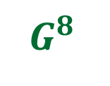
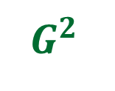
Theorem:
We can compute transitive closure of graph $G$ in O$(n^{ω} log n)$ time.
$$G$$
$\log{n}$ Matrix Multiplications ☺
$G^{2}$
$G^{4}$
$G^{8}$
…
$$G^{n−1}$$

Slide 10
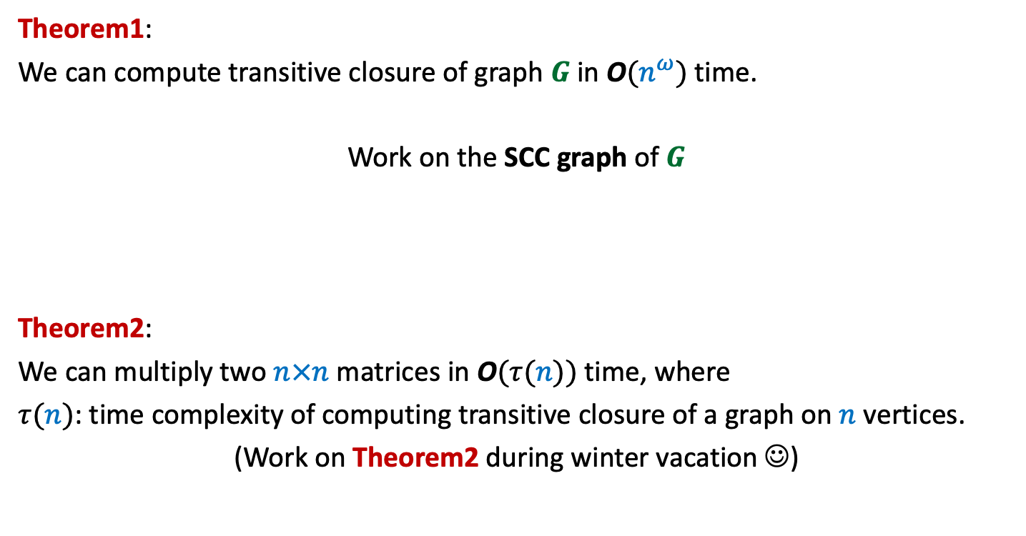
Theorem1:
We can compute transitive closure of graph $G$ in O$(n^{ω})$ time.
Work on the SCC graph of $G$
Theorem2:
We can multiply two $n×n$matrices in O$(τ(n))$ time, where
$τ(n)$: time complexity of computing transitive closure of a graph on $n$ vertices.
(Work on Theorem2 during winter vacation ☺)
Same time complexity

Slide 11
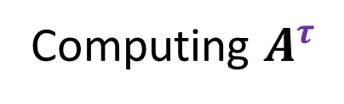


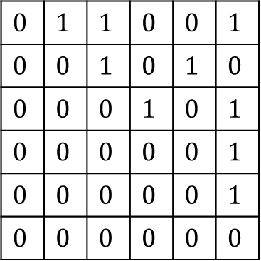


Computing $A^{τ}$
$$1$$ |  | $$…$$ |  |  | $$n$$
$$1$$
$$:$$
$$n$$
0
$$0$$ | $$1$$ | $$1$$ | $$0$$ | $$0$$ | $$1$$
$$0$$ | $$0$$ | $$1$$ | $$0$$ | $$1$$ | $$0$$
$$0$$ | $$0$$ | $$0$$ | $$1$$ | $$0$$ | $$1$$
$$0$$ | $$0$$ | $$0$$ | $$0$$ | $$0$$ | $$1$$
$$0$$ | $$0$$ | $$0$$ | $$0$$ | $$0$$ | $$1$$
$$0$$ | $$0$$ | $$0$$ | $$0$$ | $$0$$ | $$0$$
$$A$$
$$1 … \frac{n}{2} \frac{n}{2}+1 n$$
SCC($G$)

Slide 12



Computing $A^{τ}$
$$1$$ |  | $$…$$ |  |  | $$n$$
$$1$$
$$:$$
$$n$$
0
$$0$$ | $$1$$ | $$1$$ | $$0$$ | $$0$$ | $$1$$
$$0$$ | $$0$$ | $$1$$ | $$0$$ | $$1$$ | $$0$$
$$0$$ | $$0$$ | $$0$$ | $$1$$ | $$0$$ | $$1$$
$$0$$ | $$0$$ | $$0$$ | $$0$$ | $$0$$ | $$1$$
$$0$$ | $$0$$ | $$0$$ | $$0$$ | $$0$$ | $$1$$
$$0$$ | $$0$$ | $$0$$ | $$0$$ | $$0$$ | $$0$$
$$C$$
$$B$$
0
$$D$$
$$A$$
$$1 … \frac{n}{2} \frac{n}{2}+1 n$$

Slide 13



Computing $A^{τ}$
$$1$$ |  | $$…$$ |  |  | $$n$$
Compute$B^{τ}$
$$1$$
$$:$$
$$n$$
0
$$0$$ | $$1$$ | $$1$$ | $$0$$ | $$0$$ | $$1$$
$$0$$ | $$0$$ | $$1$$ | $$0$$ | $$1$$ | $$0$$
$$0$$ | $$0$$ | $$0$$ | $$1$$ | $$0$$ | $$1$$
$$0$$ | $$0$$ | $$0$$ | $$0$$ | $$0$$ | $$1$$
$$0$$ | $$0$$ | $$0$$ | $$0$$ | $$0$$ | $$1$$
$$0$$ | $$0$$ | $$0$$ | $$0$$ | $$0$$ | $$0$$
$$C$$
$$B$$
0
$$D$$
$$A$$
$$1 … \frac{n}{2} \frac{n}{2}+1 n$$
$$i$$
$$j$$

Slide 14



Computing $A^{τ}$
$$1$$ |  | $$…$$ |  |  | $$n$$
Compute$B^{τ}$
$$1$$
$$:$$
$$n$$
0
$$0$$ | $$1$$ | $$1$$ | $$0$$ | $$0$$ | $$1$$
$$0$$ | $$0$$ | $$1$$ | $$0$$ | $$1$$ | $$0$$
$$0$$ | $$0$$ | $$0$$ | $$1$$ | $$0$$ | $$1$$
$$0$$ | $$0$$ | $$0$$ | $$0$$ | $$0$$ | $$1$$
$$0$$ | $$0$$ | $$0$$ | $$0$$ | $$0$$ | $$1$$
$$0$$ | $$0$$ | $$0$$ | $$0$$ | $$0$$ | $$0$$
$$C$$
Compute$D^{τ}$
$$B$$
0
$$D$$
$$A$$
$$1 … \frac{n}{2} \frac{n}{2}+1 n$$
$$i$$
$$j$$

Slide 15






Computing $A^{τ}$
$$j$$
$$1$$ |  | $$…$$ |  |  | $$n$$
Compute$B^{τ}$
$$1$$
$$:$$
$$n$$
0
$C$
$$0$$ | $$1$$ | $$1$$ | $$0$$ | $$0$$ | $$1$$
$$0$$ | $$0$$ | $$1$$ | $$0$$ | $$1$$ | $$0$$
$$0$$ | $$0$$ | $$0$$ | $$1$$ | $$0$$ | $$1$$
$$0$$ | $$0$$ | $$0$$ | $$0$$ | $$0$$ | $$1$$
$$0$$ | $$0$$ | $$0$$ | $$0$$ | $$0$$ | $$1$$
$$0$$ | $$0$$ | $$0$$ | $$0$$ | $$0$$ | $$0$$
$$C$$
Compute$D^{τ}$
$$i$$
$$B$$
0
$$i$$
$$D$$
$$A$$
$$1 … \frac{n}{2} \frac{n}{2}+1 n$$
$$i$$
$$j$$
$$i→j$$

Slide 16







Computing $A^{τ}$
$$k$$
$$j$$
$$1$$ |  | $$…$$ |  |  | $$n$$
Compute$B^{τ}$
$$1$$
$$:$$
$$n$$
0
$C$
$$0$$ | $$1$$ | $$1$$ | $$0$$ | $$0$$ | $$1$$
$$0$$ | $$0$$ | $$1$$ | $$0$$ | $$1$$ | $$0$$
$$0$$ | $$0$$ | $$0$$ | $$1$$ | $$0$$ | $$1$$
$$0$$ | $$0$$ | $$0$$ | $$0$$ | $$0$$ | $$1$$
$$0$$ | $$0$$ | $$0$$ | $$0$$ | $$0$$ | $$1$$
$$0$$ | $$0$$ | $$0$$ | $$0$$ | $$0$$ | $$0$$
$$i$$
$$C$$
Compute$D^{τ}$
$$B$$
$$B^{τ}C$$
$$k$$
0
$$D$$
$$A$$
$$1 … \frac{n}{2} \frac{n}{2}+1 n$$
$$i$$
$$k$$
$$j$$
$i$ $⇝$ $k$
$$→j$$

Slide 17







Computing $A^{τ}$
$$k$$
$$j$$
$$1$$ |  | $$…$$ |  |  | $$n$$
Compute$B^{τ}$
$$1$$
$$:$$
$$n$$
0
$C$
$$0$$ | $$1$$ | $$1$$ | $$0$$ | $$0$$ | $$1$$
$$0$$ | $$0$$ | $$1$$ | $$0$$ | $$1$$ | $$0$$
$$0$$ | $$0$$ | $$0$$ | $$1$$ | $$0$$ | $$1$$
$$0$$ | $$0$$ | $$0$$ | $$0$$ | $$0$$ | $$1$$
$$0$$ | $$0$$ | $$0$$ | $$0$$ | $$0$$ | $$1$$
$$0$$ | $$0$$ | $$0$$ | $$0$$ | $$0$$ | $$0$$
$$i$$
$$C$$
Compute$D^{τ}$
$$B$$
$$B^{τ}C$$
$CD^{τ}$
0
$$k$$
$$D$$
$$A$$
$$1 … \frac{n}{2} \frac{n}{2}+1 n$$
$$i$$
$$k$$
$$j$$
$$i→k$$
$⇝$ $j$

Slide 18







Computing $A^{τ}$
$$1$$ |  | $$…$$ |  |  | $$n$$
Compute$B^{τ}$
$$1$$
$$:$$
$$n$$
0
$C$
$$0$$ | $$1$$ | $$1$$ | $$0$$ | $$0$$ | $$1$$
$$0$$ | $$0$$ | $$1$$ | $$0$$ | $$1$$ | $$0$$
$$0$$ | $$0$$ | $$0$$ | $$1$$ | $$0$$ | $$1$$
$$0$$ | $$0$$ | $$0$$ | $$0$$ | $$0$$ | $$1$$
$$0$$ | $$0$$ | $$0$$ | $$0$$ | $$0$$ | $$1$$
$$0$$ | $$0$$ | $$0$$ | $$0$$ | $$0$$ | $$0$$
$$C$$
Compute$D^{τ}$
$$B$$
$B^{τ}C$
$CD^{τ}$
0
$$D$$
$$A$$
$$1 … \frac{n}{2} \frac{n}{2}+1 n$$
$$i$$
$$p$$
$$k$$
$$j$$
$i$ $⇝$ $p$
$⇝$ $j$
$$→k$$
Homework: Ponder over it. We shall discuss it in the next class.

Slide 19

Interested in Research in Algorithms related to Matrices?
Dr. Pravesh Kothari
Talk: 5:15 PM, KD101, 1st November
Meeting: 3:00 – 5:00 PM, KD202, 1st November

Slide 20

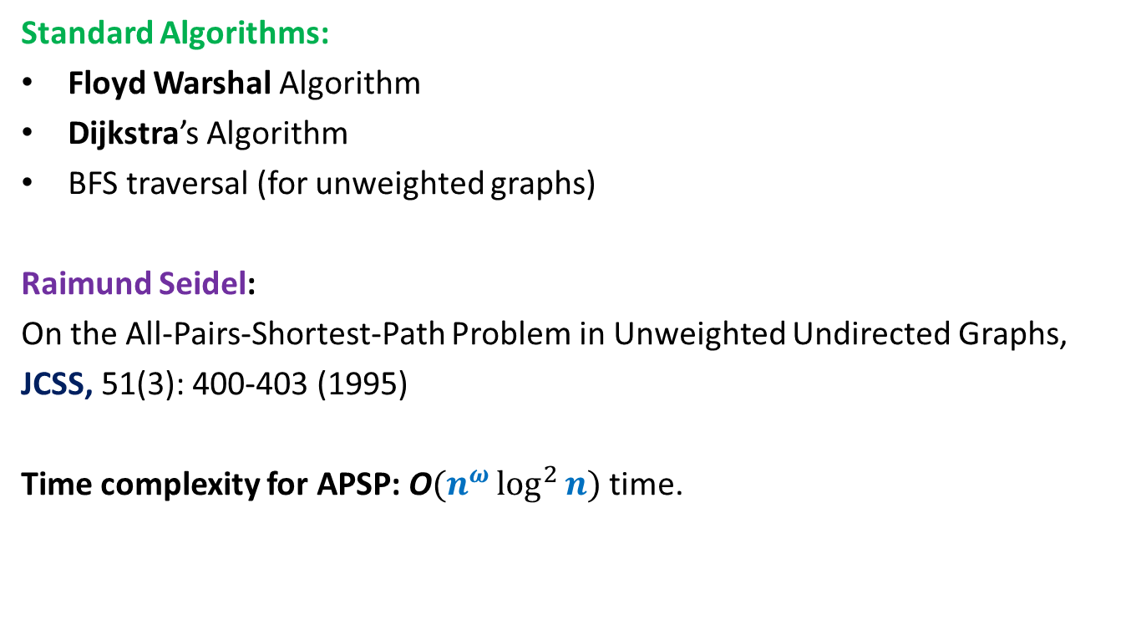
All Pairs Shortest Paths (APSP)
Matrix Multiplication
Standard Algorithms:
Floyd Warshal Algorithm
Dijkstra’s Algorithm
BFS traversal (for unweighted graphs)
Raimund Seidel:
On the All-Pairs-Shortest-Path Problem in Unweighted Undirected Graphs,
JCSS, 51(3): 400-403 (1995)
Time complexity for APSP: O$(n^{ω}\log^{2}{n})$ time.
O$(n^{3})$ time in the worst case

Slide 21









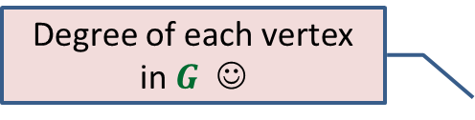
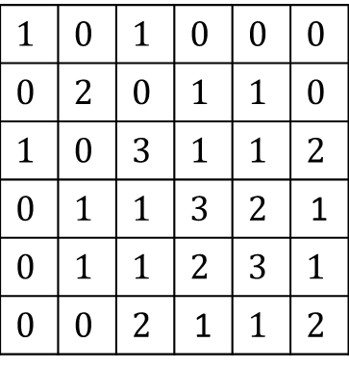



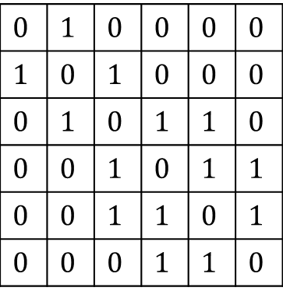

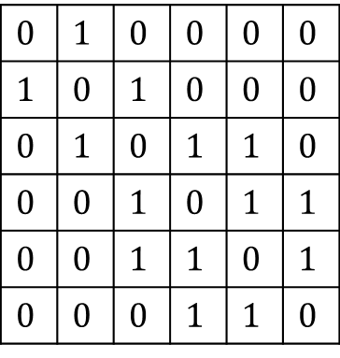


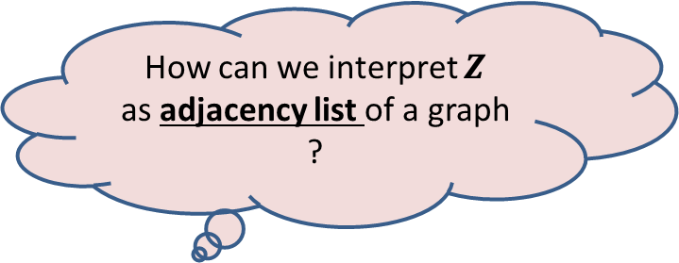

Degree of each vertex in $G$ ☺
$$1$$ | $$2$$ | $$3$$ | $$4$$ | $$5$$ | $$6$$
$$1$$
$$2$$
$$3$$
$$4$$
$$5$$
$$6$$
$$0$$ | $$1$$ | $$0$$ | $$0$$ | $$0$$ | $$0$$
$$1$$ | $$0$$ | $$1$$ | $$0$$ | $$0$$ | $$0$$
$$0$$ | $$1$$ | $$0$$ | $$1$$ | $$1$$ | $$0$$
$$0$$ | $$0$$ | $$1$$ | $$0$$ | $$1$$ | $$1$$
$$0$$ | $$0$$ | $$1$$ | $$1$$ | $$0$$ | $$1$$
$$0$$ | $$0$$ | $$0$$ | $$1$$ | $$1$$ | $$0$$
$$0$$ | $$1$$ | $$0$$ | $$0$$ | $$0$$ | $$0$$
$$1$$ | $$0$$ | $$1$$ | $$0$$ | $$0$$ | $$0$$
$$0$$ | $$1$$ | $$0$$ | $$1$$ | $$1$$ | $$0$$
$$0$$ | $$0$$ | $$1$$ | $$0$$ | $$1$$ | $$1$$
$$0$$ | $$0$$ | $$1$$ | $$1$$ | $$0$$ | $$1$$
$$0$$ | $$0$$ | $$0$$ | $$1$$ | $$1$$ | $$0$$
$$1$$ | $$0$$ | $$1$$ | $$0$$ | $$0$$ | $$0$$
$$0$$ | $$2$$ | $$0$$ | $$1$$ | $$1$$ | $$0$$
$$1$$ | $$0$$ | $$3$$ | $$1$$ | $$1$$ | $$2$$
$$0$$ | $$1$$ | $$1$$ | $$3$$ | $$2$$ | 1
$$0$$ | $$1$$ | $$1$$ | $$2$$ | $$3$$ | $$1$$
$$0$$ | $$0$$ | $$2$$ | 1 | $$1$$ | $$2$$
$$0$$
$$0$$
$$0$$
$$1$$
$$0$$
$$1$$
$$1$$
$$0$$
$$1$$
$$0$$
$$A$$
$$A$$
$$B$$
$$Z$$
$$B_{ij}=\left\{\begin{aligned}1 if Z_{ij}≠0 \\ 0 otherwise \end{aligned}\right.$$
$Z_{ii}$ : degree of$i$in $G$
$$4$$
How can we interpret $Z$
as adjacency list of a graph ?
$$6$$
$$1$$
$$2$$
$$3$$
$$G$$
$$5$$

Slide 22


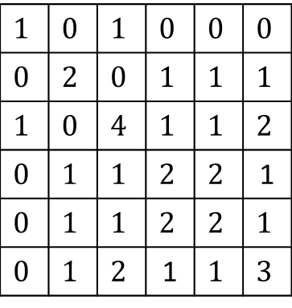






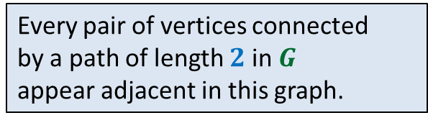
$$1$$ | $$2$$ | $$3$$ | $$4$$ | $$5$$ | $$6$$
$$1$$
$$2$$
$$3$$
$$4$$
$$5$$
$$6$$
$$0$$ | $$1$$ | $$0$$ | $$0$$ | $$0$$ | $$0$$
$$1$$ | $$0$$ | $$1$$ | $$0$$ | $$0$$ | $$0$$
$$0$$ | $$1$$ | $$0$$ | $$1$$ | $$1$$ | $$0$$
$$0$$ | $$0$$ | $$1$$ | $$0$$ | $$1$$ | $$1$$
$$0$$ | $$0$$ | $$1$$ | $$1$$ | $$0$$ | $$1$$
$$0$$ | $$0$$ | $$0$$ | $$1$$ | $$1$$ | $$0$$
$$0$$ | $$1$$ | $$0$$ | $$0$$ | $$0$$ | $$0$$
$$1$$ | $$0$$ | $$1$$ | $$0$$ | $$0$$ | $$0$$
$$0$$ | $$1$$ | $$0$$ | $$1$$ | $$1$$ | $$0$$
$$0$$ | $$0$$ | $$1$$ | $$0$$ | $$1$$ | $$1$$
$$0$$ | $$0$$ | $$1$$ | $$1$$ | $$0$$ | $$1$$
$$0$$ | $$0$$ | $$0$$ | $$1$$ | $$1$$ | $$0$$
$$1$$ | $$0$$ | $$1$$ | $$0$$ | $$0$$ | $$0$$
$$0$$ | $$2$$ | $$0$$ | $$1$$ | $$1$$ | $$1$$
$$1$$ | $$0$$ | $$4$$ | $$1$$ | $$1$$ | $$2$$
$$0$$ | $$1$$ | $$1$$ | $$2$$ | $$2$$ | 1
$$0$$ | $$1$$ | $$1$$ | $$2$$ | $$2$$ | $$1$$
$$0$$ | $$1$$ | $$2$$ | 1 | $$1$$ | $$3$$
$$0$$
$$0$$
$$0$$
$$1$$
$$0$$
$$1$$
$$1$$
$$0$$
$$1$$
$$0$$
$$A$$
$$A$$
$$B$$
$$B_{ij}=\left\{\begin{aligned}1 if Z_{ij}≠0 \\ 0 otherwise \end{aligned}\right.$$
or $A_{ij}=1$
$$4$$
$$4$$
$$6$$
$$6$$
$$1$$
$$2$$
$$3$$
$$1$$
$$2$$
$$3$$
How would you interpret this row ?
Every pair of vertices connected
by a path of length $2$ in $G$
appear adjacent in this graph.
Let us also add each edge of $G$as well to this graph if it is not already there
$$G$$
$$5$$
$$5$$
$$G^{2}$$

Slide 23











$$1$$ | $$2$$ | $$3$$ | $$4$$ | $$5$$ | $$6$$
$$j$$
$$1$$
$$2$$
$$3$$
$$4$$
$$5$$
$$6$$
$$0$$ | $$1$$ | $$0$$ | $$0$$ | $$0$$ | $$0$$
$$1$$ | $$0$$ | $$1$$ | $$0$$ | $$0$$ | $$0$$
$$0$$ | $$1$$ | $$0$$ | $$1$$ | $$1$$ | $$0$$
$$0$$ | $$0$$ | $$1$$ | $$0$$ | $$1$$ | $$1$$
$$0$$ | $$0$$ | $$1$$ | $$1$$ | $$0$$ | $$1$$
$$0$$ | $$0$$ | $$0$$ | $$1$$ | $$1$$ | $$0$$
$$0$$ | $$1$$ | $$0$$ | $$0$$ | $$0$$ | $$0$$
$$1$$ | $$0$$ | $$1$$ | $$0$$ | $$0$$ | $$0$$
$$0$$ | $$1$$ | $$0$$ | $$1$$ | $$1$$ | $$0$$
$$0$$ | $$0$$ | $$1$$ | $$0$$ | $$1$$ | $$1$$
$$0$$ | $$0$$ | $$1$$ | $$1$$ | $$0$$ | $$1$$
$$0$$ | $$0$$ | $$0$$ | $$1$$ | $$1$$ | $$0$$
$$i$$
$B_{ij}$ = $1$ if and only if there is a path between $i$ and $j$ of length $≤k+ℓ$
$$A′$$
$$A"$$
$$Z$$
Adj. Matrix of $G^{k}$
Adj. Matrix of $G^{ℓ}$
$$B_{ij}=\left\{\begin{aligned}1 if Z_{ij}≠0 \\ 0 otherwise \end{aligned}\right.$$
or ${A′}_{ij}=1$
or ${A”}_{ij}=1$

Slide 24
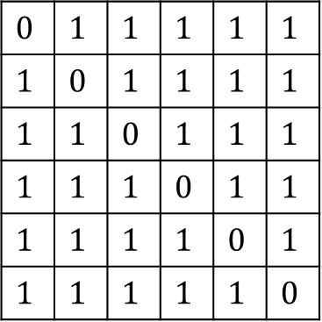
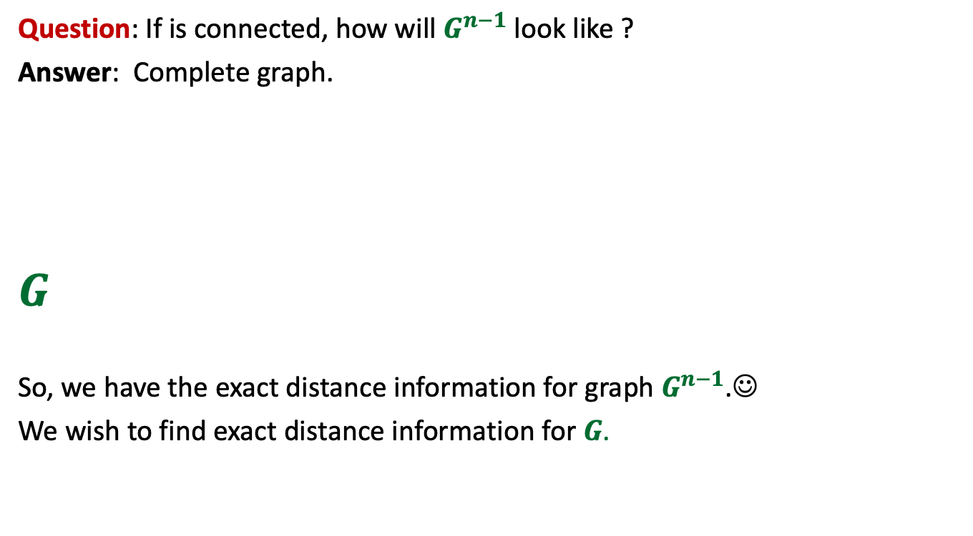

$$0$$ | $$1$$ | $$1$$ | $$1$$ | $$1$$ | $$1$$
$$1$$ | $$0$$ | $$1$$ | $$1$$ | $$1$$ | $$1$$
$$1$$ | $$1$$ | $$0$$ | $$1$$ | $$1$$ | $$1$$
$$1$$ | $$1$$ | $$1$$ | $$0$$ | $$1$$ | $$1$$
$$1$$ | $$1$$ | $$1$$ | $$1$$ | $$0$$ | $$1$$
$$1$$ | $$1$$ | $$1$$ | $$1$$ | $$1$$ | $$0$$
Question: If is connected, how will $G^{n−1}$ look like ?
Answer: Complete graph.
$$G$$
So, we have the exact distance information for graph $G^{n−1}$.☺
We wish to find exact distance information for $G$.
?
$G^{2}$
$G^{4}$
$G^{8}$
…
$$G^{n−1}$$
How do we proceed ?

Slide 25
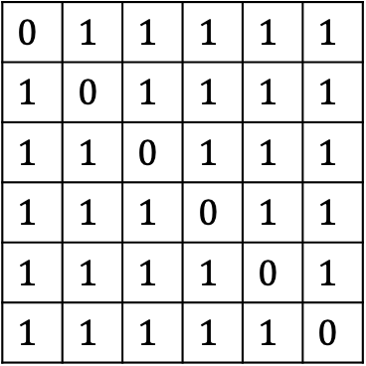

$$0$$ | $$1$$ | $$1$$ | $$1$$ | $$1$$ | $$1$$
$$1$$ | $$0$$ | $$1$$ | $$1$$ | $$1$$ | $$1$$
$$1$$ | $$1$$ | $$0$$ | $$1$$ | $$1$$ | $$1$$
$$1$$ | $$1$$ | $$1$$ | $$0$$ | $$1$$ | $$1$$
$$1$$ | $$1$$ | $$1$$ | $$1$$ | $$0$$ | $$1$$
$$1$$ | $$1$$ | $$1$$ | $$1$$ | $$1$$ | $$0$$
$$G$$
?
$G^{2}$
$G^{4}$
$G^{8}$
…
$$G^{n−1}$$

Slide 26

Question: Given distance matrix $D′$ of $G^{2}$,
how to compute distance matrix $D$ of $G$ ?

Slide 27










Distance in $G^{2}$ Distance in $G$
?
If $D_{ij}$is even ➔ ${D′}_{ij}$ = $\frac{D_{ij}}{2}$
If $D_{ij}$is odd ➔ ${D′}_{ij}$ = $\frac{D_{ij} + 1}{2}$
$$G^{2}$$
$$D′$$
$$i$$
$$j$$
$$G$$
$$D$$
$$i$$
$$j$$

Slide 28
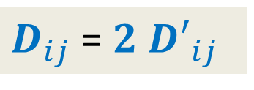

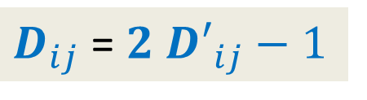
Distance in $G^{2}$ Distance in $G$
?
If $D_{ij}$is even ➔ ${D′}_{ij}$ = $\frac{D_{ij}}{2}$
If $D_{ij}$is odd ➔ ${D′}_{ij}$ = $\frac{D_{ij} + 1}{2}$
$D_{ij}$ = ${2 D′}_{ij}$
$D_{ij}$ = ${2 D′}_{ij}−1$
$$G^{2}$$
$$D′$$
$$i$$
$$j$$
$$G$$
$$D$$
$$i$$
$$j$$
Great ! So in order to compute $D$ from $D′$, all we need to determine is the parity of each $D_{ij}$.

Slide 29






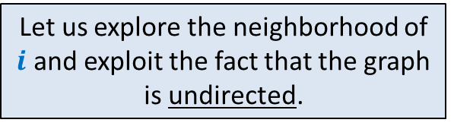


Let us explore the neighborhood of $i$ and exploit the fact that the graph is undirected.
Question: How to determine if $D_{ij}$is even or odd ?
$D_{ij}−1{≤D}_{kj}≤$ $D_{ij}+1$
$D_{ij}$is even ➔ For each neighbor $k$ of $i$
$D_{ij}$is odd ➔ For each neighbor $k$ of $i$
$${D′}_{kj}<{D′}_{ij}$$
$$k$$
What about this neighbor ?
?
$$G$$
$$i$$
$$j$$
$${D′}_{kj}≥{D′}_{ij}$$
$${D′}_{kj}≤{D′}_{ij}$$

Slide 30




Theorem:
If $D_{ij}$is even, then for each neighbor $k$ of $i$ , ${D′}_{kj}≥{D′}_{ij}$
If $D_{ij}$is odd, then for each neighbor $k$ of $i$ , ${D′}_{kj}≤{D′}_{ij}$
AND there exists at least one neighbor $k$ such that ${D′}_{kj}<{D′}_{ij}$.
How to determine whether $D_{ij}$is even or odd ?
$$C$$
?
$$D′$$
Homework: Ponder over it. We shall discuss it in the next class.

